Slide 1
Action Research
Dirk Riehle, Univ. Erlangen
NYT D04
Licensed under CC BY 4.0 International

Slide 2
Agenda
Action research
Participatory action research
The action research process
Quality assurance

Slide 3
1. Action Research

Slide 4
Action Research
Action research is a research methodology in which the researcher
Iterates over applying, evaluating, and revising a theory
To cause change and build out the theory
Key is
The active involvement (the “action” and/or “intervention”) and
Its expected effects in the world
The researcher is not just a distant observer!

Slide 5
Duality of Purpose
The goal of action research is to
Improve practice
Build out a theory

Slide 6
The Action Research Process
The action research process uses established research methods to
Set initial goals
Iterate over
Choose focus
Plan the action
Execute the action
Observe the outcome
Build out the theory
The researcher is not necessarily participating (executing) the plan themselves
An outside researcher is a facilitator
An inside researcher is a participant

Slide 7
Three Motivations for Action Research
Technical action research is interested in
Improving control over outcomes
Educational action research is motivated by
Helping practitioners act more wisely
Critical action research is motivated by
Emancipating practitioners

Slide 8
Variants of Action Research
Action research (AR) is a
Research methodology (as before)
Participatory action research (PAR) is action research in which
The researcher is an active participant of the whole research process
Critical (theory) participatory action research is action research in which
The research uses critical theory as the underlying epistemological position
Critical theory seeks
“to liberate human beings from the circumstances that enslave them” [1]
[1] Horkheimer, M. (1982). Critical Theory Selected Essays. New York: Continuum Publishing.

Slide 9
As a Research Methodology Category
Action research (Lewin, 1951)
Participatory action research (McIntyre, 2008)
Critical participatory action research (Kemmis et al., 2014)

Slide 10
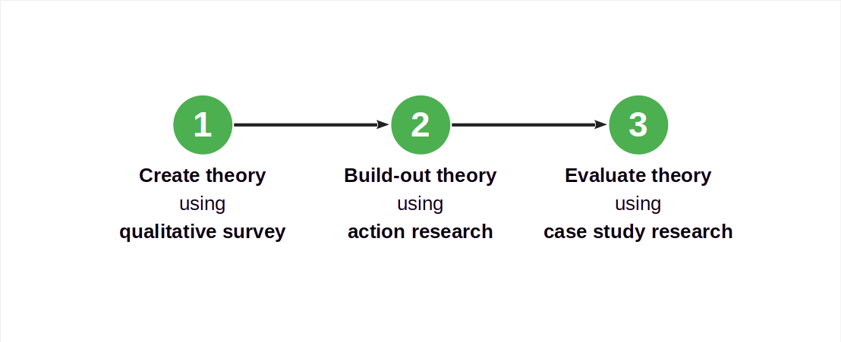
Action Research in a Larger Research Design

Slide 11
A Sweet Spot for Action Research
Participatory action research is a good choice if
The researcher has access to appropriate cases
The theory under development is evolving quickly
There is significant tacit knowledge with the researcher
Participants expect to learn/benefit from the research

Slide 12
Industry Consulting as Action Research
In industry consulting (paid or unpaid), a researcher provides advice to practitioners
Researchers are called upon to help improve the outcome of practitioner work
They do not have to be participants (of implementation), but may simply advise
Industry consulting on new, novel topics, works well with action research

Slide 13
2. Participatory Action Research

Slide 14
Participatory Action Research
Participatory action research is action research in which
Researchers and practitioners perform the research jointly and collaboratively
For the practitioners, this has the following consequences; they
Can understand and develop their practices from within case
Can develop a joint, reflective, language of critical debate
Can form communities of practice based on the research
Participatory action research is a “practice-changing practice” [K+14]

Slide 15
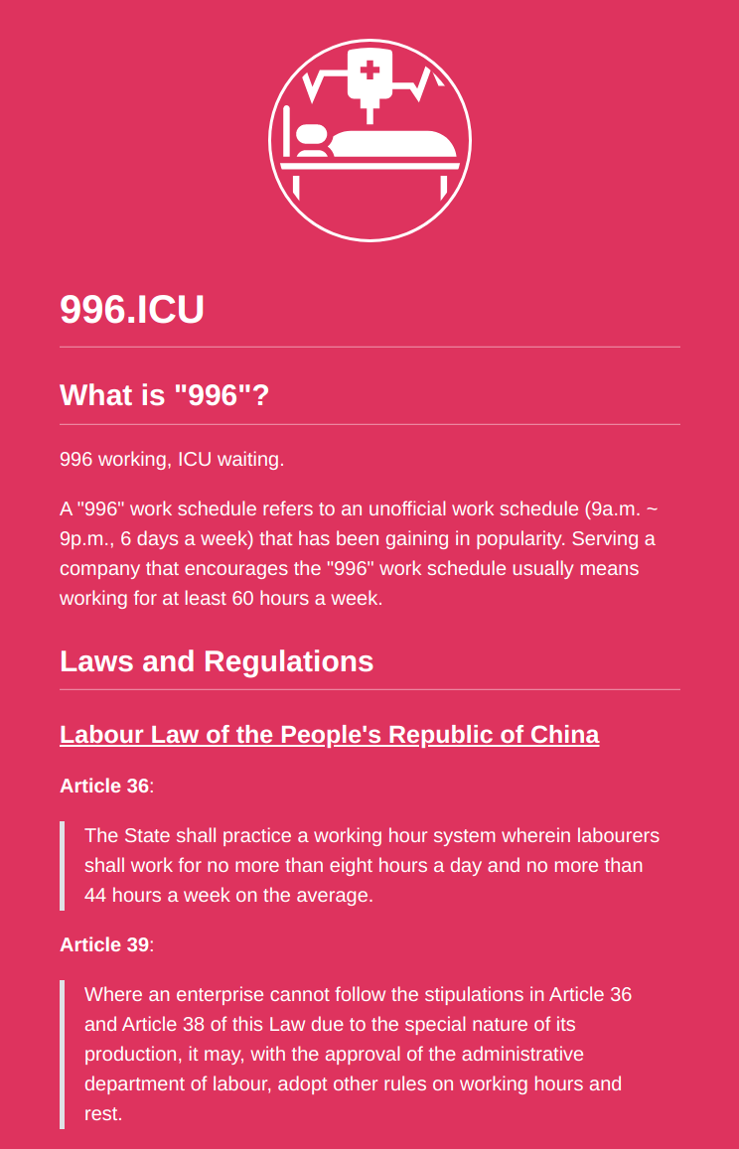
Critical Participatory Action Research
Critical participatory action research is action research that
Empowers participants to change practices in the face of
irrational
unsustainable
unjust situations
With this addition of critical theory, we are leaving positivism
No objective independent reality but rather
Individual and collective action and reflection

Slide 16
Context Specificity
Participatory action research is context-dependent research
Every research project is different and so are the employed methods
Makes action research a rather loose methodology beyond the core process

Slide 17
No Fixed Formula
Participatory action research has no single theoretical framework
A roundabout way of saying that as a methodology, it is still evolving

Slide 18
Roles in Participatory Action Research
Everyone is a participant, some are
Researchers
Practitioners
You are either a researcher or a practitioner
Researchers are temporary participants
Practitioners are typically (more) permanent participants

Slide 19
Academic Researchers vs. Practitioner Participants
In participatory action research, academic researchers
Are participants
But how do they become participants?
Do they have to be invited?
Also, can you be both?

Slide 20
Participation vs. Involvement
Participation
Participants are stakeholders
Participation may be uneven
Involvement
No agency or ownership

Slide 21
3. The Action Research Process

Slide 22
The Process and Activities of Action Research
The action research process and its activities
Set initial goals
Iterate over
Choose focus
Plan action
Execute action
Observing outcome
Build out theory

Slide 23
Properties of the Action Research Process
The action research process is
Iterative
Incremental
Repetitive

Slide 24
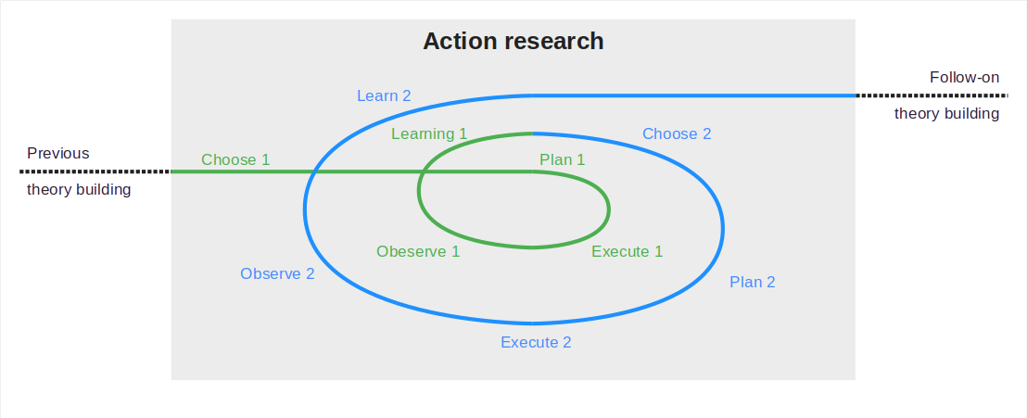
Action Research Process in Context

Slide 25
Activity Names by Methodology Variant
Generic | Action research (Lewin, 1946) | Participatory AR (McIntyre, 2008) | Critical PAR (Kemmis et al., 2014)
– | – | Questioning | –
Choosing | – | Investigating | Reconnaissance
Planning | Planning | Developing | Planning
Executing | Executing | Implementing | Enacting
Observing |  |  | Observing
Learning | Fact-finding | Refining | Reflection

Slide 26
1. Set Initial Goals
You choose action research, because
Your theory is young
You may have a project at hand
The project can benefit from your help
You offer the project to help

Slide 27
Example PAR Microservice Integration Initial Goals
After an initial qualitative survey, we have our initial theory at hand, codified as a
Handbook of microservice integration best practices
The initial goal (research question) now is to
Iteratively build out the theory through incremental use and reflection
Which happens to nicely fit participatory action research

Slide 28
2a. Choose Focus
During choosing (focus), you
Choose which aspect of your theory to build out
Criteria to choose focus by can be
Strategic: Immaturity of theory aspect chosen
Pragmatic: Aspect readily available in project
Action research will prefer pragmatic choices!
Because it is about helping practitioners

Slide 29
Example Choosing Focus
A strategic choice: Database-based communication
You motivate or wait for the project to turn to database-based communication
A pragmatic choice: Event-bus-based communication
Project is currently working on event-bus based communication

Slide 30
Planning
During planning, you
Choose an appropriate method to investigate the aspect

Slide 31
Example Planning
With the handbook of microservice integration at hand, you choose
Joint design sessions to determine a target architecture
Pre-session and post implementation practitioner interviews

Slide 32
Execution
During execution, you follow your plan and
Participate in the project working on the aspect of choice

Slide 33
Example Execution
As you participate in the project, you follow your plan:
You interview the practitioners before the first session
You participate in the design sessions

Slide 34
Observation
During observation, you continue with your plan and
Observe the results of the execution using the methods you chose

Slide 35
Example Observation
After execution, you continue with the plan:
You wait for the implementation (or also participate)
You interview the practitioners after the implementation

Slide 36
Learning
During learning, you
Analyse the observed data towards the aspect of interest
You may still be following your plan if it also laid out the analysis and interpretation methods

Slide 37
Example Learning
After observation, you now
Analyze the interview data towards the aspect of interest
Apply more methods as needed

Slide 38
Closing
Based on what you learned, you
Either continue with another iteration of action research
Or move on to the next methodology in your research design

Slide 39
4. Quality Assurance

Slide 40
Summary
Action research
Participatory action research
The action research process
Quality assurance

Slide 41
Thank you! Any questions?
dirk.riehle@fau.de – https://oss.cs.fau.de
dirk@riehle.org – https://dirkriehle.com – @dirkriehle

Slide 42
Legal Notices
License
Licensed under the CC BY 4.0 International license
Copyright
© Copyright 2022-2023 Dirk Riehle, some rights reserved

